Slide 1
Model-free goal selection
Adam Morris & Fiery Cushman

Slide 2
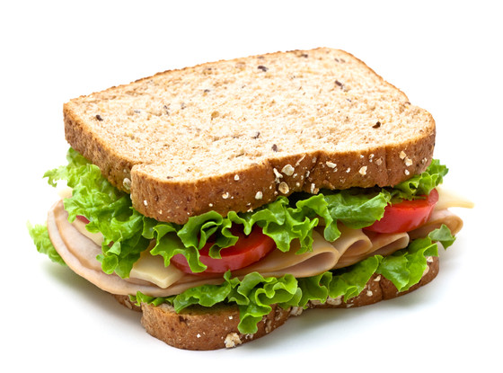
Abscond with an aardvark, abscond with an alligator…
Notes:
Someone wants to make a sandwich. As soon as they decide upon this goal, they immediately know that the next thing to do is to walk to the kitchen, open the fridge, get some bread, etc. They also know the motor routines for each of those subgoals. But how? There were infinite possible subgoals. Suppose alphabetically. Couldn’t have checked all of those.
Similar question: how could you program a robot to do it? It’s easy if you put in domain-specific knowledge, but if a robot wants to work across multiple domains, how?

Slide 3
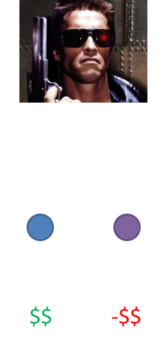

Reinforcement learning
1
good
2
bad
1
2
Model-based reinforcement learning
Model-free reinforcement learning
Goal-directed planning
Habitual actions
$$
-$$
(Sutton & Barto 1998)
Notes:
To answer that question, turn to RL.
Agent in environment. States, actions, transitions, rewards. Agent wants to maximize long-term rewards.
RL algorithms are a popular way solution. Roughly two classes.
Model-based, tree search. Model-free.
Why ever MF over MB?

Slide 4
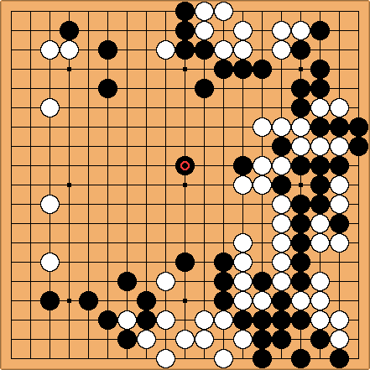
Reinforcement learning
(Silver, Sutton, & Muhler 2012)
Notes:
Because Go. MB tree search is intractable. MF is better.
But what if you could just substitute a MF value for nodes in the tree? If you know that “own this corner” is a valuable state, you can end the tree search there.
This is what modern Go algorithms do. Learn from experience MF values for nodes, & then do a tree search on how to reach valuable nodes.

Slide 5
Reinforcement learning
1
good
2
bad
1
2
Model-based reinforcement learning
Model-free reinforcement learning
Goal of
good
Goal of
bad
$$
-$$
Model-free goal selection?
(Silver, Sutton, & Muhler 2012)
Notes:
In our game, learn value of blue & purple. Then plan to get blue.
We know people do the other two types. Do people also form these habitual goals? Commonsense notion: habit of thought. Breaking bad example.
3 experiments. Applications.

Slide 6
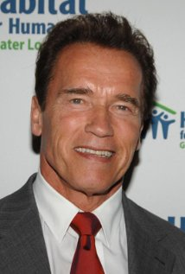
Reinforcement learning
1
good
2
bad
1
2
Model-based reinforcement learning
Goal-directed planning
Model-free reinforcement learning
Habitual actions
Goal of
good
Goal of
bad
$$
-$$
Habitual goals?
(Dolan & Dayan 2013)

Slide 7
Distinguishing MB & MF
1
2
??
??
(Gläscher et al. 2010)
Notes:
Distinguish between MB & MF.

Slide 8
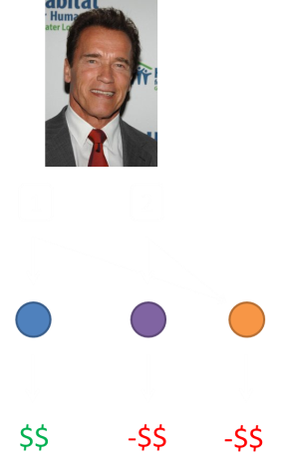
Distinguishing MB & MF
1
bad
1
2
Goal of
bad
??
??
??
-$$
(Gläscher et al. 2010)
Notes:
Add “low-prob” transition. Chooses 1, transitions to yellow, gets punishment.
MB learns nothing. MF learns that 1 is bad. So if people are less likely to choose 1 on the next turn, MF.
But goal MF?

Slide 9
Our experiment
1
2
??
??
??
Notes:
Our experiment

Slide 10
Our experiment
1
2
3
4
??
??
??
??
??
Notes:
Now two options lead to blue, & two lead to purple. Blues are the same & purples are the same – rewards are tied. Presented with two options on every trial. Rewards varied throughout experiment.

Slide 11
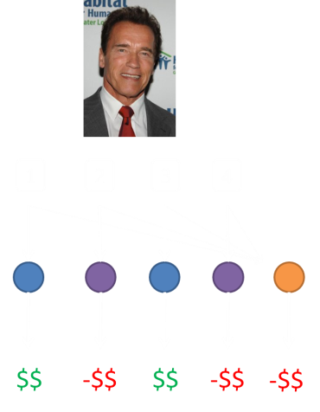
Our experiment
1
bad
1
2
3
4
Goal of
bad
??
??
??
??
-$$
??
Notes:
Critical trial: 1 and 2, choose 1, transition to yellow, get punishment.
Pure MB learns nothing. MF learns 1 is bad. MF-goal learns blue is bad.

Slide 12
Our experiment
1
bad
1
2
3
4
Goal of
bad
??
??
??
??
-$$
Notes:
Next trial: options 3 & 4. Pure MB predicts nothing. Pure MF predicts nothing. MF-goal predicts less likely to choose 3.

Slide 13
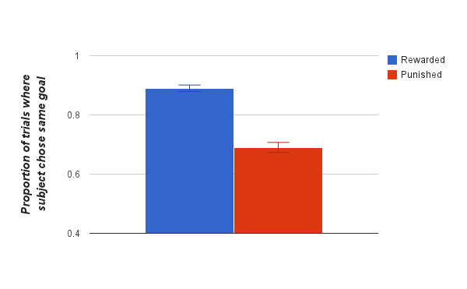
Our experiment
*
Orange’s value
Choice on next trial
β = .191, p < .0001
Notes:
Results (w/ real people): much less likely to choose 3.

Slide 14
Experiment #2
1
2
3
4
??
??
??
??
??
Notes:
Problem w/ experiment #1: What if people are just associating actions 1 & 3, and treating them as one action?

Slide 15
Experiment #2
1
2
3
4
??
??
??
??
??
Notes:
Two features on which shapes varied, & two types of trials.
On color trial, color determined reward.

Slide 16
Experiment #2
Color trial
1
2
3
4
??
??
??
??
??
Notes:
On color trial, color determined reward.

Slide 17
Experiment #2
Color trial
1
2
3
4
$$
-$$
$$
-$$
??
Notes:
For example…

Slide 18
Experiment #2
Color trial
Shape trial
1
2
3
4
??
??
??
??
??
Notes:
On shape trial, shape determines reward.

Slide 19
Experiment #2
Color trial
Shape trial
1
2
3
4
$$
$$
-$$
-$$
??
Notes:
For example…

Slide 20
Experiment #2
Color trial
Shape trial
1
2
3
4
??
??
??
??
-$$
??
Notes:
Critical trial: It’s a color trial. 1 and 2, choose 1, transition to yellow, receive punishment.

Slide 21
Experiment #2
Color trial
Shape trial
1
2
3
4
Goal of
bad
??
??
??
??
-$$
Prediction: We’ll only see the effect on “matching” critical trials.
Notes:
Next trial: 2 and 3. Suppose it’s a color trial. Then the same logic as before applies, & people should be less likely to choose 3.
But suppose it’s a shape trial. If people were really just making statistical associations between 1 and 3, they should again be less likely to choose 3. But if they’re really forming these MF goal values, then there will be no effect – b/c you can’t set goal of getting blue on shape trial!

Slide 22
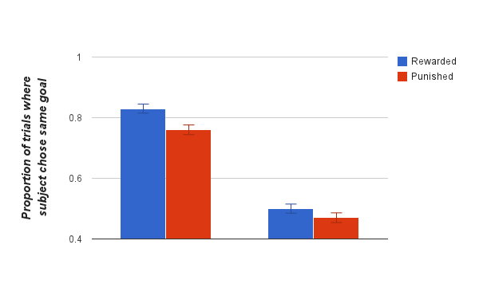
Experiment #2
*
ns
Matching
Non-matching
Orange’s value * Type of critical trial
Choice on next trial
β = .049, p < .01
Notes:
Results
Problem w/ previous experiments: How do we know that these MF goal values are actually being incorporated into MB tree search?

Slide 23
Experiment #3
A
B
C
D
1
2
3
4
Notes:
Introduced new options: A-D. Trained people on these deterministic transitions.

Slide 24
Experiment #3
1
2
3
4
??
??
??
??
-$$
??
Notes:
Then they went into normal game. Most trials, normal.
But on critical trial: 1 and 2, choose 1, transition to yellow, punishment.

Slide 25
Experiment #3
A
B
C
D
1
2
3
4
Goal of
bad
??
??
??
??
-$$
Notes:
Next trial, reintroduced the separately-learned transitions. If people are really incorporating the MF goal value into tree search, less likely to choose C.

Slide 26
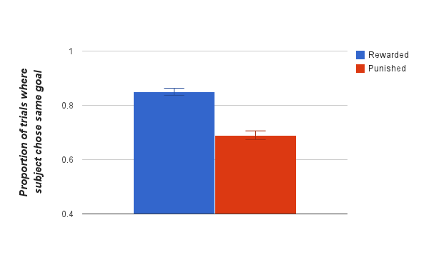
Experiment #3
*
Orange’s value
Choice on next trial
β = .143, p < .0001
Notes:
Results

Slide 27
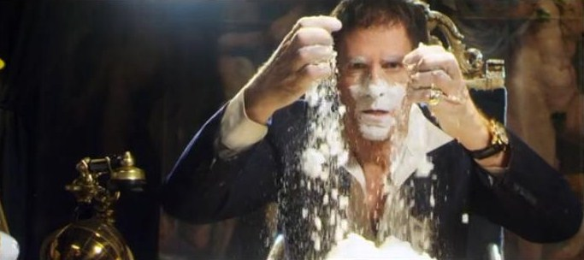
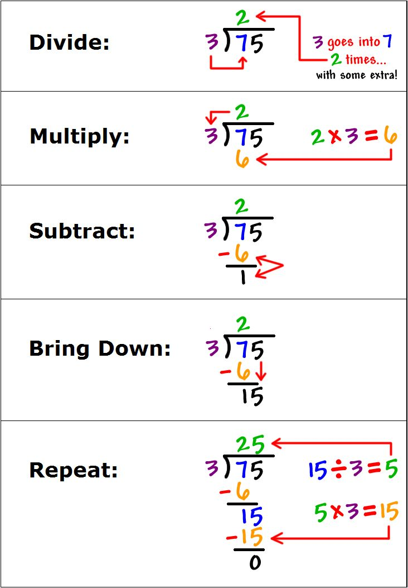
Psychological Phenomena
Habit-like features of goals (Huang & Bargh 2014)
Notes:
What psychological phenomena does this help explain?
Habit-like features of goals: can be automatically activated by contextual cues, unconsciously reinforced, intrusive
Drug addiction: Debated whether drug-seeking behavior is habitual or goal-directed. Can be both (like ice cream example).
Complex cognitive skills: e.g. long division. Divided into hierarchical goals + subgoals. Might be acquiring proper subgoal activation habits.

Slide 28
AI Implications
Notes:
Already using it to play Go. Robot decision making more broadly?

Slide 29

Thank you!

